Slide 1

Amazon Prime Video Analysis
KARMUKILAN D K

Slide 2
Contents of This Template
Introduction
Key Findings
Detailed Insights
Conclusion
Recommendations

Slide 3
About Dataset
Analysis of Amazon Prime Video content dataset comprising 9668 entries.
Examination of various aspects including types of shows, directors, cast, countries, ratings, durations, and categories.

Slide 4
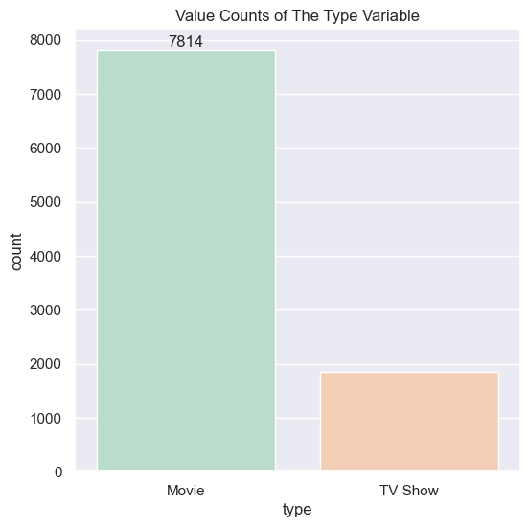
Show Types Distribution
Movies: 7814 (80.82%)
TV Shows: 1854 (19.18%)

Slide 5
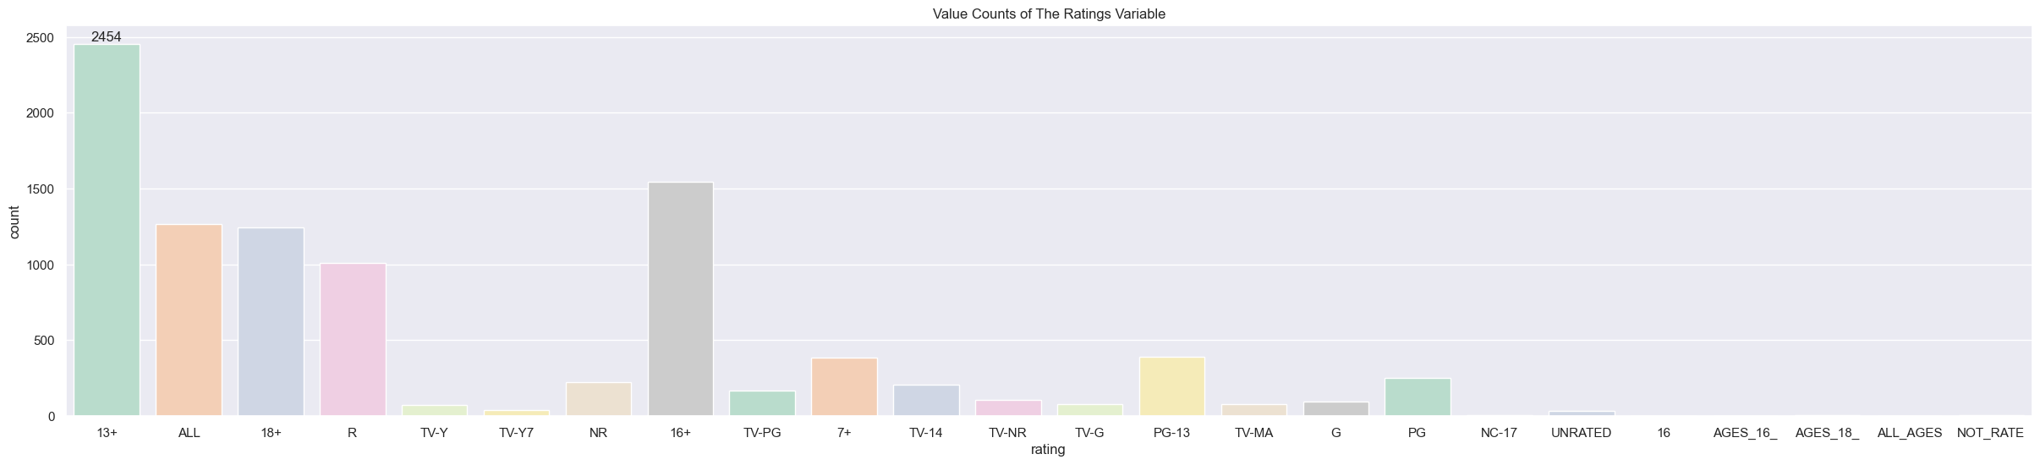
Top Ratings
Majority of shows (9331, 96.44%) have a rating of 13+.

Slide 6
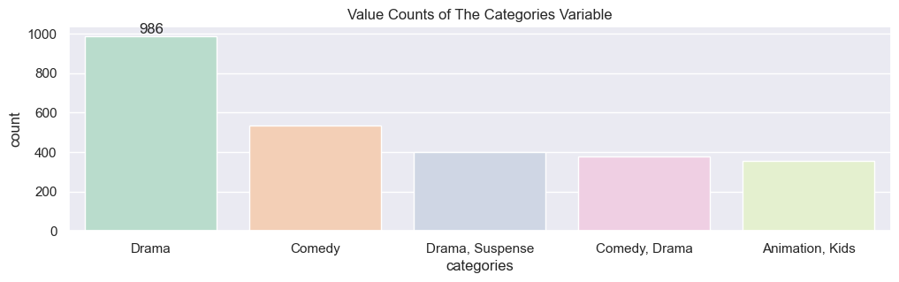
Most Common Category
Drama is the predominant category with 986 entries.

Slide 7
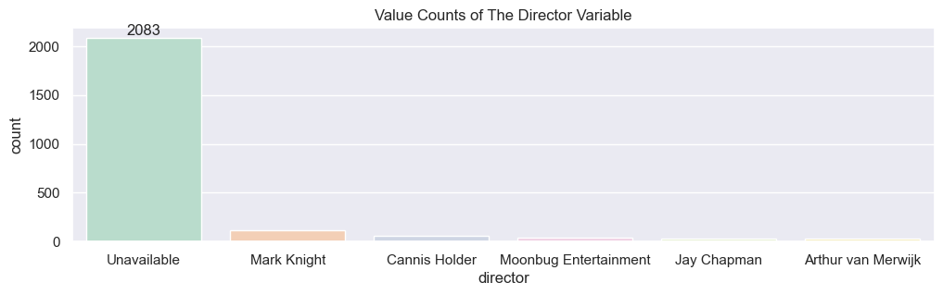
Director Insights
Mark Knight stands out as the most prolific director with 113 shows.

Slide 8
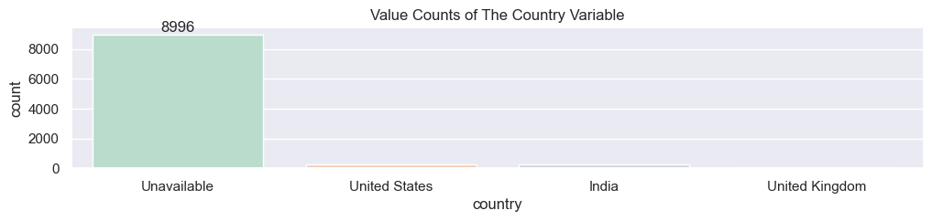
Country
United States leads as the country with the most content (253 entries).

Slide 9
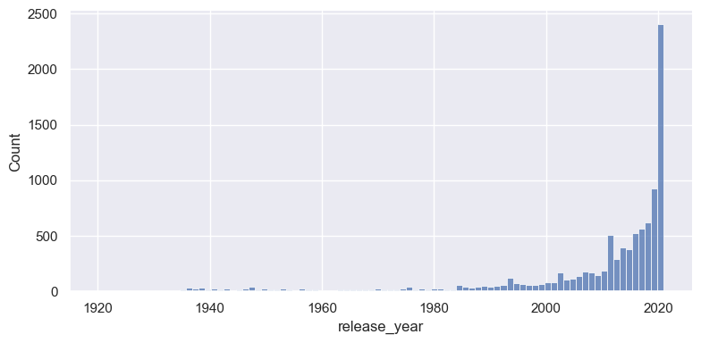
Yearly Trend
Shows primarily released in 2020 indicating a recent trend.

Slide 10
Conclusion
Amazon Prime Video predominantly features Movie content over TV shows.
Shows from the US, particularly in the Drama genre, are prevalent.
Mark Knight emerges as a significant Director and contributor to Amazon Prime Video's content library.
The platform exhibits a consistent trend of releasing more Movie content compared to TV shows.
A notable preference for 13+ rated drama shows is observed.

Slide 11
THANK YOU
Please keep this slide for attribution

